Slide 1
Presented by The NABIP Diversity, Equity, Inclusion & Belonging Committee

Slide 2
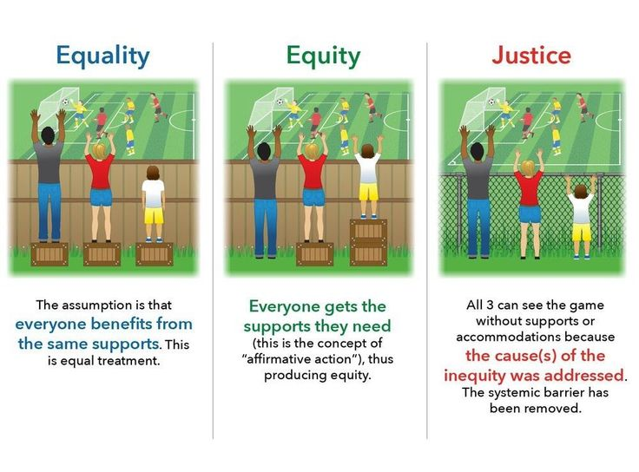

Slide 4
NABIP Diversity, Equity , and Inclusion Mission
To provide Diversity, Equity and Inclusion (DEI) experiences that actively engage us in learning from each other to mitigate unconscious bias, educate on racial injustice, exclude discrimination of all forms, increase equity, and foster inclusion throughout the National Association of Benefits and Insurance Professionals (NABIP).
Vision & Core Values
Leverage the diversity of our membership to reflect the communities we serve, as well as the products and services we deliver
Align policies, practices, programming, resources so all members have opportunities to thrive
Create an environment in which everyone feels valued and respected

Slide 5
